Slide 1
Semantic Elements

Slide 2
Semantic Elements
Smantic elements involve a handful of tags that can be used to define specific parts of a page, such as articles, headers, footers, and navigation.
HTML5 offers new semantic elements to define different parts of a web page:
<article>
<aside>
<details>
<figcaption>
<figure>
<footer>
<header>
<main>

Slide 3
Semantic Elements
<mark>
<nav>
<section>
<summary>
<time>

Slide 4
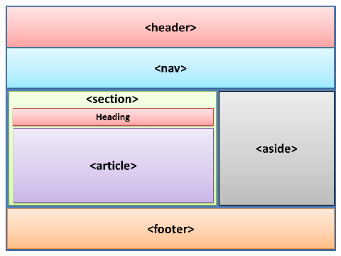
Semantic Elements

